Slide 1
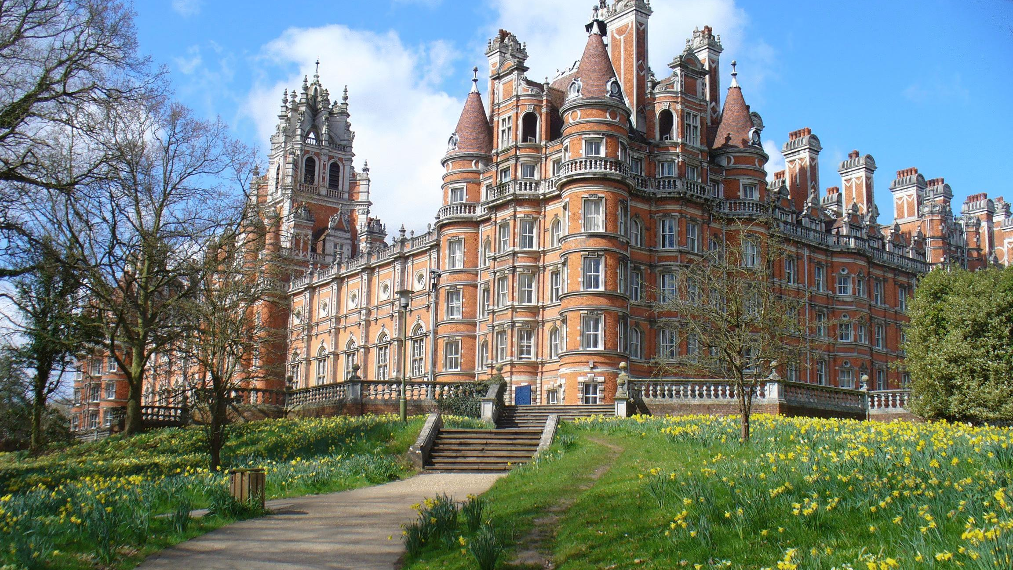
Oxford

Slide 2
Medicine
 | UCAS code | A100 |  | Duration | 3 years (BA) 6 years (BM BCh)
 | Entrance requirements | A*AA (excluding Critical Thinking, Thinking Skills and General Studies) |  | Subject requirements | Essential: Chemistry with either Maths, Further Maths, Biology or Physics
 | Admissions test(s) | BMAT |  | Written work | None
 | Admissions statistics* | Interviewed: 25% Successful: 9% Intake: 159 ^{*3-year average 2018-20} |  | Contact | Email Medicine

Slide 3
BMAT(Biomedical Admissions Test)
If you are applying for one of the following courses you will be required to sit the BMAT: Biomedical Sciences, Medicine, Medicine (Graduate Entry).
The Biomedical Admissions Test lasts 2 hours and is sat under timed conditions. The BMAT is divided into three sections. Section 1 tests problem solving, understanding argument, and data analysis and inference. Section 2 is based on the knowledge typically included in non-specialist school Science and Mathematics courses. It tests your ability to apply this knowledge – possibly in unfamiliar contexts. Section 3 tests the capacity to develop ideas and to communicate them effectively in writing. It is not a test of knowledge.

Slide 4
Biochemistry (Molecular and Cellular)
 | UCAS code | C700 |  | Duration | 4 years (MBiochem)
 | Entrance requirements | A*AA including Chemistry and another science or Maths, with the A* in Maths, Physics, Chemistry, or Biology (or a very closely related subject) |  | Subject requirements | Essential: Chemistry and another science or Maths Recomanded:Maths Helpful: Biology (beyond GCSE)
 | Admissions test(s) | None |  | Written work | None
 | Admissions statistics* | Interviewed: 52% Successful: 15% Intake: 104 ^{*3-year average 2018-20} |  | Contact | Email Biochemistry

Slide 5
Biology
 | UCAS code | C100 |  | Duration | 4 years (MBiol) 3 years (BA)
 | Entrance requirements | A*AA (with the A* in a science or Maths) |  | Subject requirements | Essenrtial: Biology and either Chemistry, Physics or Maths
 | Admissions test(s) | None |  | Written work | None
 | Admissions statistics* | Interviewed: 55% Successful: 17% Intake: 114 ^{*3-year average 2018-20} |  | Contact | +44 (0) 1865 281214 Email Biology

Slide 6
Chemistry
 | UCAS code | F100 |  | Duration | 4 years (MChem)
 | Entrance requirements | A*A*A (with both A*s in science subjects and/or Maths) |  | Subject requirements | Essential: Chemistry and Maths Recommanded: Another science or Further Maths
 | Admissions test(s) | None |  | Written work | None
 | Admissions statistics* | Interviewed: 89% Successful: 29% Intake: 193 ^{*3-year average 2018-20} |  | Contact | +44 (0) 1865 272568 Email Chemistry

Slide 7
Physics
 | UCAS code | F303 |  | Duration | 4 years (MPhys) 3 years (BA)
 | Entrance requirements | A*AA (with the A* in Physics, Maths or Further Maths) |  | Subject requirements | Essential: Physics and Maths Recommanded: Maths Mechanics modules Helpful: Further Maths
 | Admissions test(s) | ox.ac.uk/pat |  | Written work | None
 | Admissions statistics* | Interviewed: 33% Successful: 13% Intake: 182 ^{*3-year average 2018-20} |  | Contact | +44 (0) 1865 272200 Email Physics

Slide 8
Mathematics
 | UCAS code | G100 |  | Duration | 3 years (BA) 4 years (MMath)
 | Entrance requirements | A*A*A with the A*s in Maths and Further Maths if taken |  | Subject requirements | Essential: Maths Recomanded: Further Maths
 | Admissions test(s) | ox.ac.uk/mat |  | Written work | None
 | Admissions statistics* | Interviewed: 34% Successful: 11% Intake: 186 ^{*3-year average 2018-20} |  | Contact | +44 (0)1865 273586 Email Maths Please note that we are currently working from home. Please email where possible.

Slide 9
Economics and Management
 | UCAS code | LN12 |  | Duration | 3 years (BA)
 | Entrance requirements | A*AA (with Maths at A or A*) |  | Subject requirements | Maths
 | Admissions test(s) | ox.ac.uk/tsa (Section 1) |  | Written work | None
 | Admissions statistics* | Interviewed: 21% Successful: 6% Intake: 89 ^{*3-year average 2018-20} |  | Contact | +44 (0) 1865 271098 Email Economics and Management

Slide 10
Psychology (Experimental)
 | UCAS code | C830 |  | Duration | 4 years (MSci in Experimental Psychology) 3 years (BA)
 | Entrance requirements | A*AA |  | Subject requirements | Recommanded: One or more science subjects (including Psychology) or Maths
 | Admissions test(s) | ox.ac.uk/tsa |  | Written work | None
 | Admissions statistics* | Interviewed: 35% Successful: 13% Intake: 59 *3-year average for 3 year BA 2018-20 |  | Contact | +44 (0) 1865 271353 Email Psychology

Slide 11
Psychology, Philosophy and Linguistics
 | UCAS code | See course combinations |  | Duration | 4 years (MSci) - CV85 and CQ81 3 years (BA) - VQ51
 | Entrance requirements | A*AA |  | Admissions statistics* | Interviewed: 36% Successful: 12% Intake: 30 *3-year average 3 year BA 2018-20
 | Admissions test(s) | ox.ac.uk/tsa |  | Written work | None
 | Subject requirements | For Psychology: one or more sciences (including Psychology) or Maths For Linguistics: English Language, Maths, a science or language |  | Contact | +44 (0) 1865 271353 Email Psychology +44 (0) 1865 276926 Email Philosophy +44 (0) 1865 280400 Email Linguistics

Slide 12
Geography
 | UCAS code | L700 |  | Duration | 3 years (BA)
 | Entrance requirements | A*AA |  | Subject requirements | Recommanded：Geography
 | Admissions test(s) | ox.ac.uk/tsa |  | Written work | None
 | Admissions statistics* | Interviewed: 60% Successful: 20% Intake: 87 ^{*3-year average 2018-20} |  | Contact | +44 (0) 1865 275887 Email Geography

Slide 13
History
 | UCAS code | V100 |  | Duration | 3 years (BA)
 | Entrance requirements | AAA |  | Subject requirements | Recommanded：History
 | Admissions test(s) | ox.ac.uk/hat |  | Written work | One piece
 | Admissions statistics* | Interviewed: 71% Successful: 23% Intake: 244 ^{*3-year average 2018-20} |  | Contact | +44 (0) 1865 615013 Email History

Slide 14
A Archaeology and Anthropology B Biochemistry (Molecular and Cellular) Biology Biomedical Sciences C Chemistry Classical Archaeology and Ancient History Classics Classics and English Classics and Modern Languages Classics and Oriental Studies Computer Science Computer Science and Philosophy E Earth Sciences (Geology) Economics and Management Engineering Science English Language and Literature English and Modern Languages European and Middle Eastern Languages | F Fine Art G Geography H History History (Ancient and Modern) History and Economics History and English History and Modern Languages History and Politics History of Art Human Sciences L Law (Jurisprudence) | M Materials Science Mathematics Mathematics and Computer Science Mathematics and Philosophy Mathematics and Statistics Medicine Medicine (graduate entry) Modern Languages Modern Languages and Linguistics Music O Oriental Studies P Philosophy and Modern Languages Philosophy, Politics and Economics (PPE) Philosophy and Theology Physics Physics and Philosophy Psychology (Experimental) Psychology, Philosophy and Linguistics R Religion and Oriental Studies T Theology and Religion

Slide 15



